Slide 1
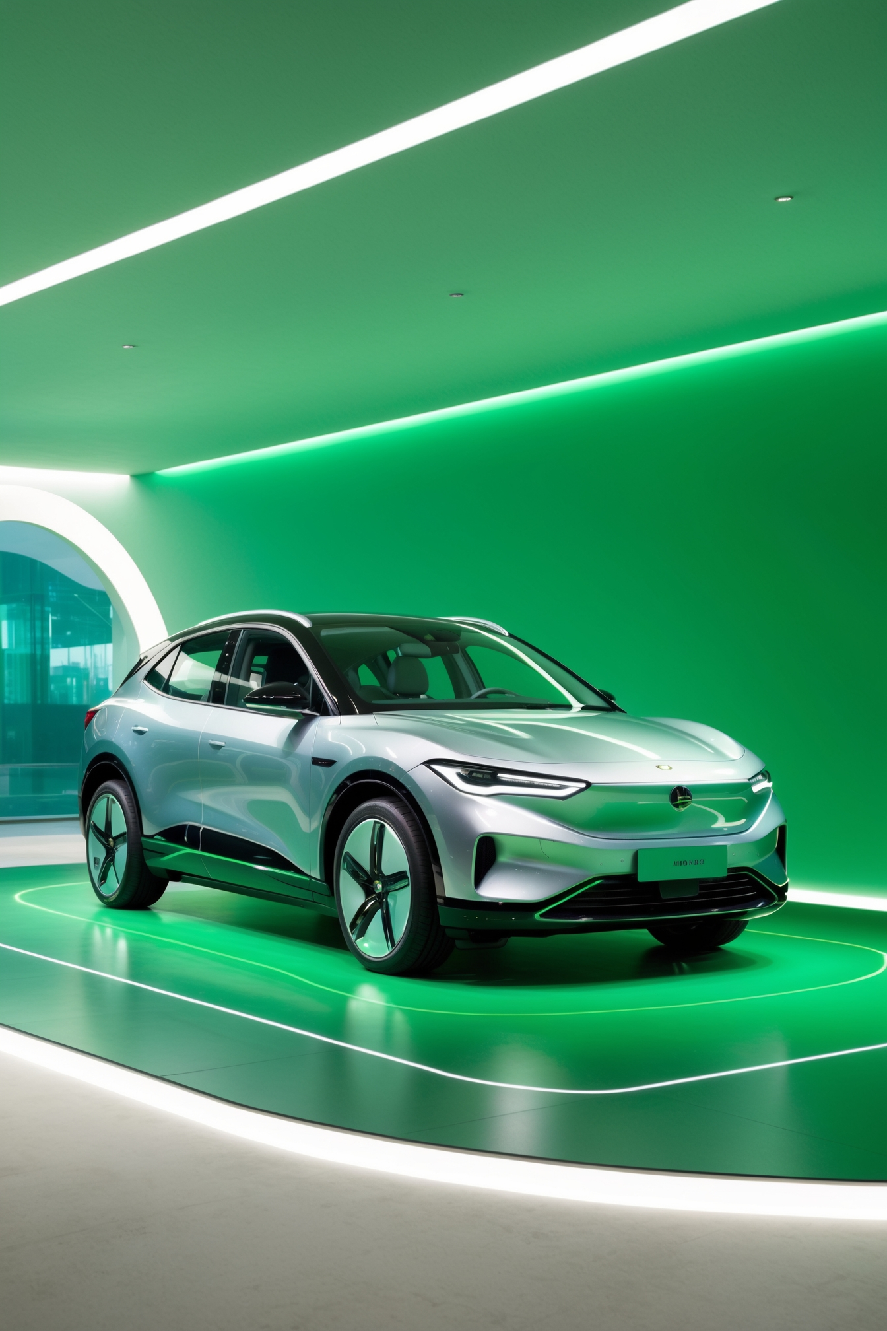
EV- SALES ANALYSIS REPORT
Created by- Udit Kumar Shukla
Course- Da/DS 24

Slide 2
STORY TELLING
In this rapidly changing world of electric vehicles (EVs), compare the pricing of four key car types: EVs, non-EVs, plug-in hybrids, and battery electric vehicles. In these four segments, we primarily compare different types of EV automobiles using static analysis, such as the Z-test and the T-test. Our goal is to examine whether the pricing disparities between these groups are statistically significant. This technique not only shows the cost differences between ancient and current automobile technology, but it also enables consumers and manufacturers to make informed decisions based on reliable facts. In this data, we examine the sales of several EV variations and use time series analysis, regression models, and forecasting approaches to anticipate future price movement and adoption rates in these vehicle categories. These predictions aid in identifying possible market shifts and guiding strategic planning for both customers and manufacturers, allowing them to stay ahead in a competitive and continually changing automotive industry. In this study report, we determine how much profit can be made across various areas and nations, and we discover that Asia-Pacific countries have larger profit margins, while many other countries, such as Denmark, France, and China, have a lot of sales. As a result, this market will provide significant information for developing future sales tactics and increasing profitability.

Slide 3
Insights from the data plotting on the company, models, and the number of cars that have been sold and compared to several car models, as well as their prices.
Annual Sales: Highlight the growth in annual global EV sales over the past few years (from 2012 to 2023) and compare Year-over-Year Growth Rate.
Best-Selling EVs: Include statistics on the best-selling EV models over various company’s different models globally or in specific regions and Show the market share of the top EV models.
Global Overview (2012-2023)
1.Total Vehicle Sales: Display the total number of vehicles sold globally, dividing them into non-EVs and EVs.
2.EV Sales Breakdown: Show how EV sales are divided between PHEVs and BEVs.
Visual Representation-
We can quickly visualize our data or specific fields. This can aid with better analysis by using a bar chart for each country, comparing annual sales of EVs, PHEVs, and BEVs, or by using line graphs to indicate trends in market share.

Slide 4
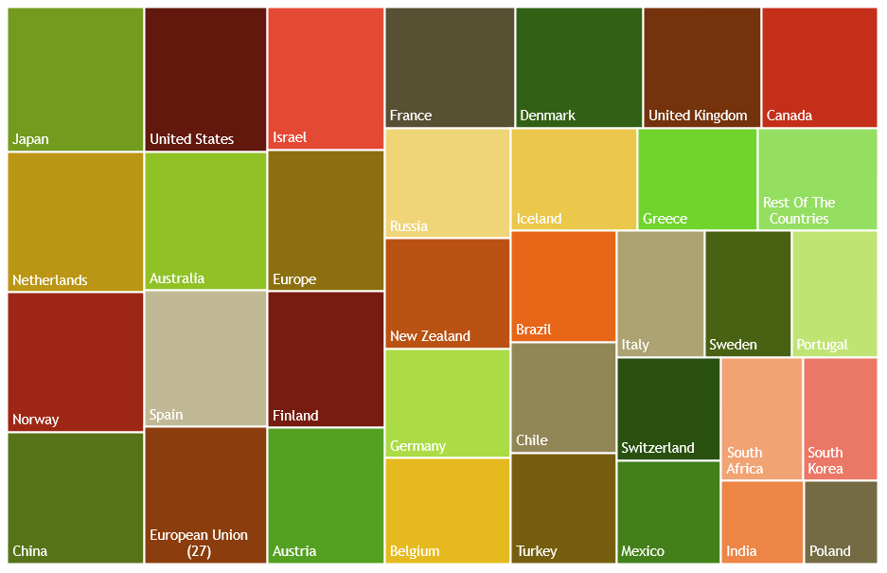
Sum Of sales over different EV cars variant by Country & Sum of cars sold(In units)

Slide 5
Insight From The Data Plotting On Country/Year/Total Sales/Ev-Units Sold
We combined several characteristics to better assess all categories, determine which country generates the most sales, and track its growth year over year.
Each country is represented by a different color, the amount of sales it generates is calculated by comparing several data fields, and the results are displayed graphically.
When we hover the cursor over any country, it displays how many sales it covers from that country, allowing us to easily identify all the countries sales year after year.
At least We all know about basics of tree map that how it will covers our data according to the user’s need so we’ll easily understand the meaning of that data.
The figures are increasing from left to right, thus Japan is at the top left, and the values will gradually decreases from top left to bottom right, with Poland having the lowest value.
So this approach provides a comprehensive comparison of sales across different vehicle types and countries, illustrating the global shift towards electric mobility.

Slide 6
Year over year sales Comparison b/w EV and Non-EV & Sub-Variants of EV
Since EV sales have somewhat increased over the last few years, non-EV car sales have gradually decreased. This pattern shows how consumer preferences are moving in favor of environmentally friendly cars.
Market shares for EVs and non-EVs are now different, with EVs gaining proportion of the market annually. Thus, it will have a direct bearing on worldwide occurrences like the COVID-19 pandemic and variations in electric vehicles (EVs), which present as having zero fuel consumption, covering a wide area annually.
BEV’s which are rely entirely on electric power, are experiencing the fastest growth among EV sub-variant’s. BEV’s are particularly renowned for his robust charging technology & strong government support such as Europe and China.
PHEV’s are as a transitional choice these are combines as internal combustion engine with an electric motor, are appealing to customers who want the benefits of electric driving without the range anxiety associated with BEV’s.

Slide 7
Year Over Year Growth In EV Sales
Consistent Double Digit Growth- EV have gradually shown his growth year over year from the past several years. This trend highlights the increasing consumer adoption of electric vehicles, driven by rising environmental awareness and also provides better technology.
Impact of Government Policies: Certain years show particularly high Year over Year growth rates, often coinciding with the introduction or expansion of government incentives, such as subsidies, tax breaks, and stricter emissions regulations.
Emerging Markets Gaining Traction- While traditionally strong markets like Japan, Europe, United States and many other countries to see the significant growth, emerging markets such as India where government supports to citizens by providing the subsidies and bans the internal combustion engines in certain regions. So These efforts will play a larger role to the overall growth of in coming years.
Infrastructure Development Boosting- The Rapid expansion of charging infrastructure, Including fast-charging networks, has removed a significant barrier to EV adoption, Contributing to the year-over-year sales increase. So this way the overall infrastructure will changes gradually especially in rural and suburban areas.

Slide 8
Company Wise Growth Of EV’s
The growth of electric vehicles (EVs) varies significantly between companies, driven by their strategies in battery electric vehicles (BEVs) and plug-in hybrid electric vehicles (PHEVs). Companies like Tesla and BYD have focused primarily on BEVs, leading to substantial growth in this segment. Tesla's dominance is largely due to its early entry, innovative technology, and extensive Supercharger network.
Companies like BMW, Mercedes-Benz, and Toyota offer both BEVs and PHEVs, aiming to meet diverse customer needs and comply with varying regulations.
As BEVs gain popularity, companies with a significant share of PHEVs are experiencing slower growth compared to those heavily invested in BEVs. As Compared To Tesla All the Companies are working on BEV’s But tesla is the only company which is working on both the models.

Slide 9
Comparing the EV market from 2010 to 2023
Sales Growth: In 2010, global EV sales were just a few thousand units as the market was in its infancy. By 2023, EV sales had surged to over 10 million units globally, driven by technological advancements, increasing environmental awareness, and supportive government policies.
Market Share: In 2010, EVs made up a tiny fraction of total vehicle sales, less than 0.1%. By 2023, EVs accounted for around 14% of global vehicle sales, with some countries like Israel, Japan, South Korea And Many Other Countries seeing more than 80% of new vehicle sales being electric.
Current EV Sales Rates Across Major Countries-
the growth of electric vehicle (EV) sales has varied significantly across different regions. In Italy, Russia, South Africa leads with over 80% of new vehicle sales being electric, driven by strong government incentives and a robust charging infrastructure. China, the world’s largest EV market, saw rapid growth with over 6 million units sold in 2023 by the support of his strong government policies.

Slide 10
Stocks Rate Comparison Over Previous 10 Years
Consistent Growth- The consistent growth in electric vehicle (EV) sales over recent years highlights a significant shift in consumer preferences toward sustainable transportation. The rise in EV sales also indicates growing confidence in the availability of charging infrastructure and the overall performance of electric vehicles. As the market continues to evolve, this steady growth suggests that EVs are becoming a mainstream choice, paving the way for a more sustainable automotive industry in the future.
Volatility and Stability- Observe the fluctuations in the stock price over the years. High volatility could be a sign of market instability, investor sentiment shifts, or external economic factors. Conversely, a stable stock rate might indicate a more reliable investment.
Price-to-Earnings (P/E) Ratio Over Time- Assess how the stock's P/E ratio has evolved. A rising P/E might suggest growing investor confidence and expectations of future earnings growth, while a declining P/E could indicate that the stock is undervalued or that earnings are expected to decrease.

Slide 11
Comparison Of EV-Sales With Z- Test & T- Test
t-Test: Two-Sample Assuming Equal Variances
 | Electric Cars Sales(In $) | Non-electric car sales
Mean | 1.38E+09 | 3124418353
Variance | 7.77E+17 | 2.98055E+18
Observations | 546 | 546
Pooled Variance | 1.88E+18
Hypothesized Mean Difference | 0
df | 1090
t Stat | -21.0029
P(T<=t) one-tail | 8.29E-83
t Critical one-tail | 1.646253
P(T<=t) two-tail | 1.66E-82
t Critical two-tail | 1.962143
Both the Z-test and T-test confirm a significant difference between EV and non-EV sales, with EVs showing considerably higher sales figures.
Significant Difference in Sales: The z-test and t-test are both used to compare the means of two groups, but they differ in their assumptions and applications. The z-test is appropriate when the sample size is large and the population variance is known, making it ideal for situations with more precise data. Conversely, the t-test is used when the sample size is small or when the population variance is unknown and must be estimated from the sample data, providing more flexibility in situations with limited or less certain data.
The consistency of results across both tests strengthens the conclusion that the EV market is experiencing robust growth, outpacing the sales of non-electric vehicles by a wide margin.
z-Test: Two Sample for Means
 | Electric Cars Sales(In $) | Non-electric car sales
Mean | 1382156278 | 3124418353
Known Variance | 7.752E+17 | 2.975E+18
Observations | 546 | 546
Hypothesized Mean Difference | 0
z | -21.02241425
P(Z<=z) one-tail | 0
z Critical one-tail | 1.644853627
P(Z<=z) two-tail | 0
z Critical two-tail | 1.959963985

Slide 12

Created By- Udit Kumar Shukla
DA/DS 24

